Slide 1
Digital Portfolio
STUDENT NAME: N SNEHA
REGISTER NO AND NMID: 2428B0015 AND asbruapbruap2428B0015
DEPARTMENT: CS DA
COLLEGE: PPG COLLEGE OF ATRS AND SCIENCE / BHARATHIYAR UNIVERSITY

Slide 2
PROJECT TITLE
SIMPLE PORTFOLIO

Slide 3


AGENDA
Problem Statement
Project Overview
End Users
Tools and Technologies
Portfolio design and Layout
Features and Functionality
Results and Screenshots
Conclusion
Github Link
3/21/2024 Annual Review

Slide 4

PROBLEM STATEMENT
In today’s digital landscape,having an online presence is cruial for personal branding and career advancement.however,many individuals lack a simple,clean,andprofessional way to showcase their skills,projects,and contact information.this project aims to solve that problem by creating a light weight,responsive portfolio website that effectivel presents an individuals professional profile.

Slide 5

PROJECT OVERVIEW
This project is a personal portfolio website built using HTML,CSS, and JAVASCRIPT .it includs an “About Me” section ,showcases multiple projects, provides a contact form ,and offers smooth navigation.it is designed to be responsive and user-friendly on both desktop and mobile devices.

Slide 6

WHO ARE THE END USERS?
The primary end users of this portfolio are:
Recruters and hiring managers
potential clients
fellow developers and collaborators
personal network(friends,mentors,etc.)

Slide 7

TOOLS AND TECHNIQUES
HTML5- Structure and content layout
CSS3-Styling and responsive design
JAVASCRIPT-Interactivity(e.g, form submission feedback)
Visual Studio Code-Code editor
Git & GitHub-version control and hosting

Slide 8
POTFOLIO DESIGN AND LAYOUT
The design follows a minimalistics and professional aesthetic:
Header:Contains the site title and navigation links
About Section: Brief introduction wit background info
Projects Section: Highlights 2 sample projects with titles and descriptions.
Contact Section: Simple form to collect name,email,and message
Footer:Copyright notice

Slide 9
FEATURES AND FUNCTIONALITY
Fully responsive layout
Smooth navigation with internal links
Interactive contact form with JavaScript-based confirmation message
Modular code struture(seperate HTML,CSS,JS File)
Clean, readable UI design

Slide 10
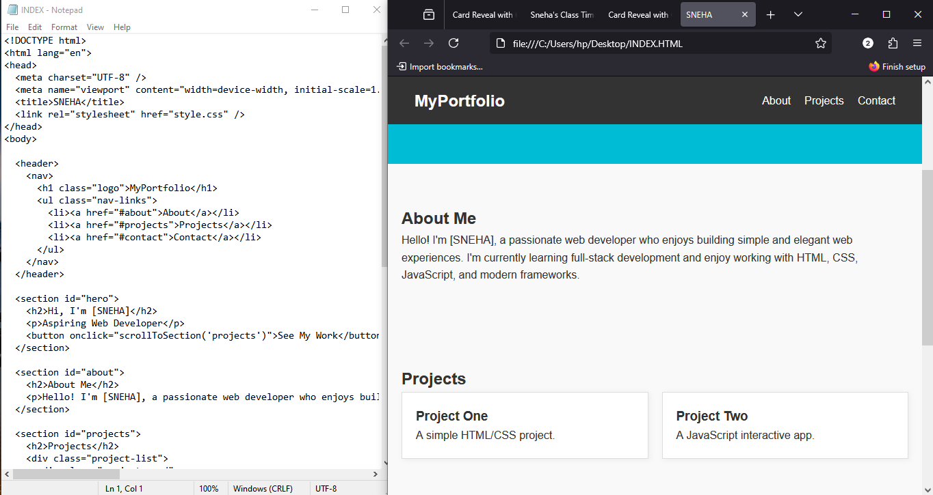

RESULTS AND SCREENSHOTS
3/21/2024 Annual Review

Slide 11
CONCLUSION
This portfolio website provides a professional and organized way to present an individual’s work and skills. It serves as astrong foundation for further development, suc as addind animations,blogs,downloadable resumes,or API-based features.

